Slide 1
Use Case & IoTDSL
Moussa Amrani, Vincent Englebet, Amanuel Koshima and Abdelmounaim Dabieche
Meeting at Cetic, Tuesday 28 June 2016

Slide 2
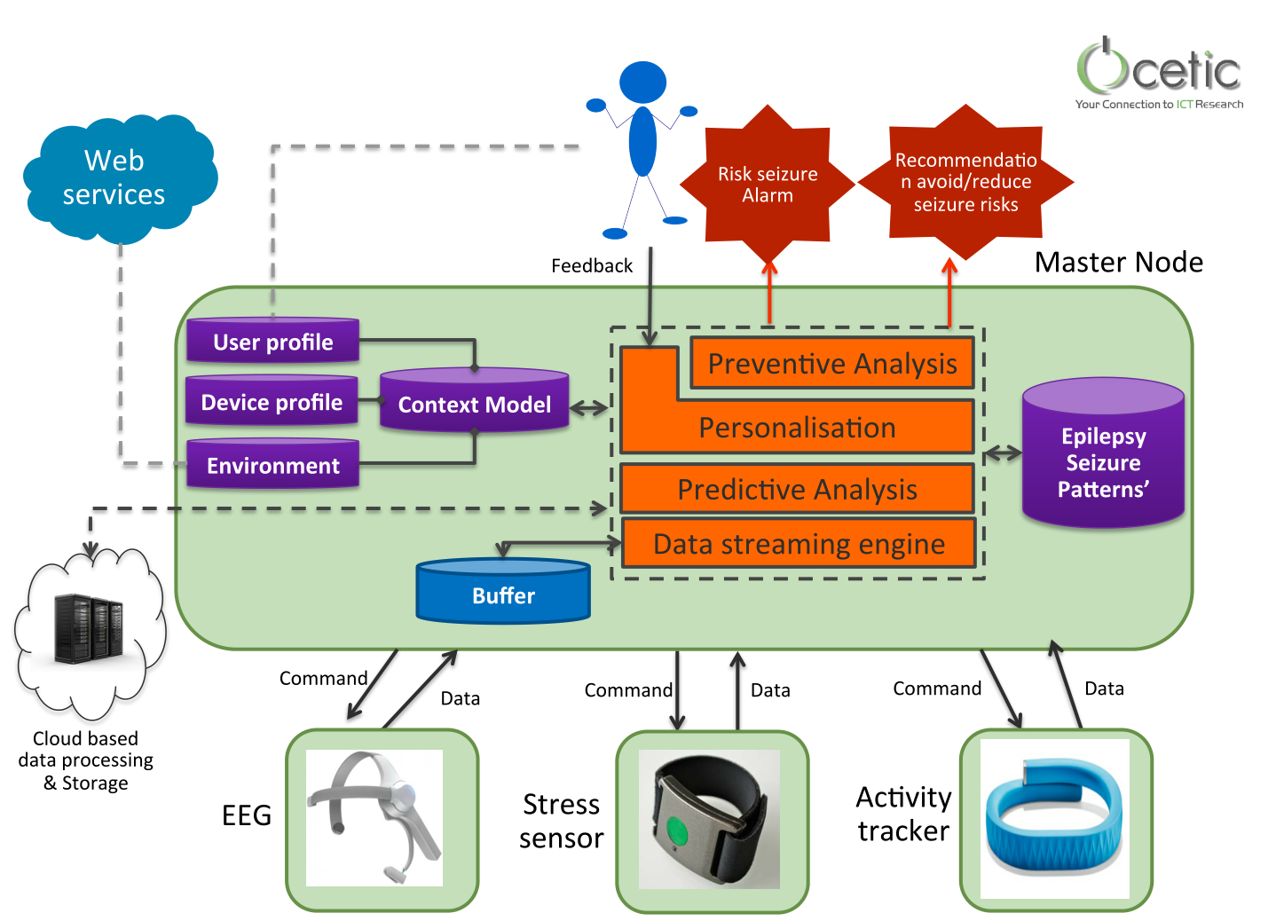
Cetic General Framework
Capture Users’ Info:
Context Modelling
Analyse Data against Knowledge
Data Mining
LEFT UC
LEFT UC
Communicate with Things:
IoT Modelling

Slide 3
Proposal
Go with 2 Ucs, with the following goals
Separate concerns as well as associated validation (Context Modelling vs. Data Mining)
Allow potentially independent work, based on common grounds
Maximize Project acceptance

Slide 4
Agenda
Uc #1: Drug Dispenser
IoTDsl in a Nutshell
Brainstorming Session

Slide 5
Drug Dispenser

Slide 6
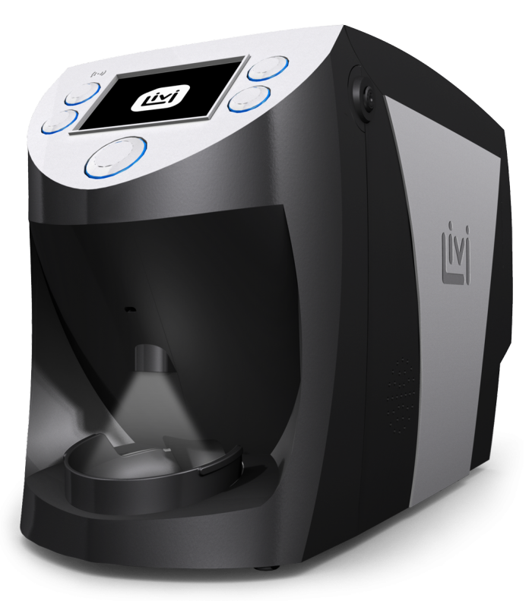
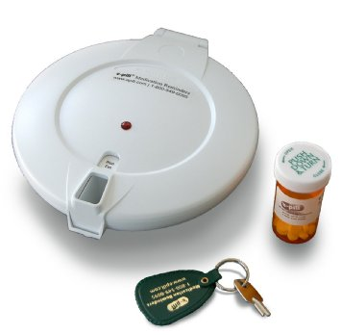

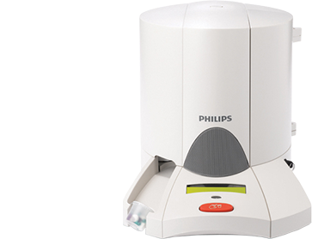
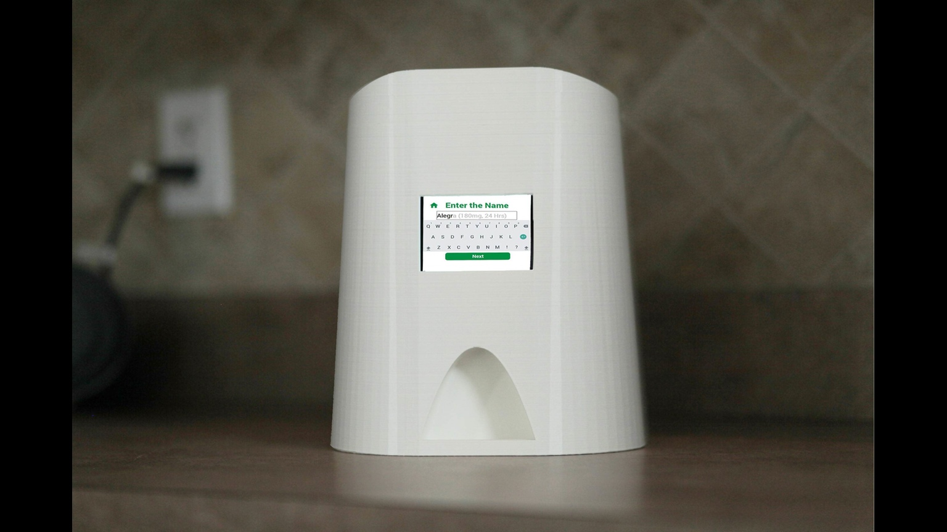
Large Market

Slide 7
Desirable Features
Programmable to face prescription changes
When
Which dosage
Which drugs
How taken
Alert in case of over-/under-dose
Classical notifications: Sms; email; phone calls
Customised, adaptive notification to the senior user
Accomodate multiple contextual uses of the same device
Two versions of the same product: pro vs. home

Slide 8
IoTDsl

Slide 9
Main Features
Fully Mde-based
Everything is modelled explicitly (even tiny native expressions)
Currently based on textual syntax for rapid prototyping
Based on metamodelling standard Omg Mof/Ecore
Clean separation of concerns
Event-Based Language for specifying interactions
Natural paradigm for embedded systems
Clean separation / interface between system and environment

Slide 10
Dsls for describing IoT configs
Devices Type Declaration
Network Configuration
Business Rules

Slide 11
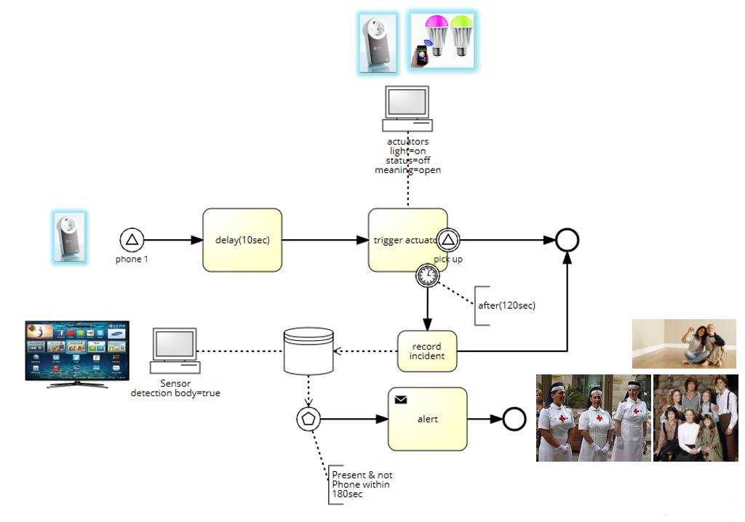
Type Declaration
enumeration Volume {V1; V2; V3;}
device Phone{
sensing receiveCall()
actuating ring(volume:Volume)
actuating setVolume(volume: Volume)
sensing pickedUp()
}
device LightBulb{
actuating on()
actuating off()
actuating blink()
}
device Timer{
actuating reset()
actuating set(delay : Volume)
sensing timeout()
}
device AlertDB{
actuating declareIncident(msg:string)
actuating alert()
}
device BodyDetector{
sensing detect()
actuating isPresent()
}
gateway Central

Slide 12
Network Configuration
configuration MyHome{
node gw : Central
node entranceBulb : LightBulb
node bathroomBulb : LightBulb
node kitchenBulb : LightBulb
node roomBulb : LightBulb
node ipPhone : Phone
node db : AlertDB
node bodydetector : BodyDetector
node timer : Timer
from entranceBulb to gw via IP
from bathroomBulb to gw via IP
from kitchenBulb to gw via IP
from roomBulb to gw via IP
from ipPhone to gw via IP
}

Slide 13
Business Rules
rule WaitBeforeBlink :
when (ipPhone.ring()) do {
timer.reset() ; timer.set(10)
}
rule BlinkAndWait:
when (timer.timeout()) do {
LightBulb.blink()
||
(timer.reset() ; timer.set(120))
}
rule PickedUpQuick:
when (ipPhone.pickedUp()) do{
LightBulb.off()
}
rule NotPickedUpAfterBlinking:
when (timer.timeout()) do{
db.declareIncident(predefinedAlert)
||
bodydetector.detect()
||
timer.reset() ; timer.set(60)
}
rule Alert:
when (timer.timeout() and bodydetector.present()) do {
db.alert()
}

Slide 14
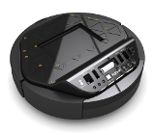
Challenges & Open Issues
Vertical: multi-platform targets
Interoperate with platforms (Samsung, Arduino, etc.)
Cope with protocol diversity
Integrate high-level specs for cross compilation
Horizontal: richer Br Language
Integrate user profiles
Specify environment context
Define users’ goals and solutions
Devices’ Capability Discovery
Bumper
IRDetector
...
Modelling
Compilation

Slide 15



Interoperability
Rely on « aggregators »
Larger scope
Less effort
Easier to maintain
Introduce dependency to tier applications
Use Intermediate Format
Big effort for development and maintenance
Total independence
Maybe constructors will help?
IoTDsl
Intermediate Format
Target 1
Target N

Slide 16
Context
Contexts help mitigate decisions [1,2]:
Internal State representation that influence decisions units (aka. rules) Examples: « all the time sensor is in alarm mode »; « continue to enforce temperature until reached »
Space Representation modelling (an abstraction of) topological constraints, without delving into topological considerations Examples: Room A is adjacent to Room B and above LR
Time Representation without an explicit notion of clocks and alike (precedence? Synchro concurrency?)
[1] Elrakaiby, Yehia and Amrani, Moussa and Le Traon, Yves. Security@Runtime: A Flexible MDE Approach to Enforce Fine-Grained Security Policies. In 6th International Symposium on Engineering Secure Software and Systems. LNCS. 2014.
[2] UsiXml Project. UsiXml Metamodelling – Definition. Project Deliverable Wp 1. 2012

Slide 17
User Profiles & HL Goals
User Profile
Gather personal data identification to distinguish users (nothing sensitive or biological)
Capture high-level description of impairments
High-Level Goal (Hlg) Description
Specify general scenario of action on the smart home
Capture relationships between Hlgs (e.g., conflicts-with, kind-of/is-a, etc.)
Hlg realisation through “Abstract” solution(s)
Describe general intention of the solution
Do not rely on particular equipment, infrastructure, etc.
User
*
*
Goal
*
*
AbstractSolution
Bob is deaf and wants to hear the phone
Use other devices: bulbs & SmartTV alerts;
Increase the phone’s volume
Alice wants to be quickly rescued when she falls at home
Wear an ePatch detector

Slide 18
Conclusion
Two Ucs focusing on different aspects of the general picture
Common basis:
Context Dsl
IoTDsl
ToDo
Find a more elaborated UC involving Data Mining
Develop Dsls using Mde

